Slide 1

Notes:
Introduction to GenevaERS Record Filtering

Slide 2
Page Objectives
Notes:
© Copyright IBM Corp. 2012, licensed under Apache 2.0 to the GenevaERS project
This page provides you with an overview of GenevaERS record filtering. It will help you:
Use GenevaERS logic text facilities to create record filters
Read GenevaERS logic text and identify keywords, fields, lookup paths, and constants
Construct complex record filters
Interpret the results of processing

Slide 3
Record Filtering
Original
Input
Record filters use conditional processing to either include or exclude records, based upon specific criteria.
Extract Record Filters:
Select source records to process.
Are performed first, before any other criteria.
If omitted, all records will be selected as input.
Extract
Phase
Extract
Work File
Format Phase Record Filters:
Select records to be written to output.
Are performed last, after all criteria, before the write is performed.
If omitted, all records will be written to output.
Format
Phase
Final
Output
Notes:
© Copyright IBM Corp. 2012, licensed under Apache 2.0 to the GenevaERS project
GenevaERS record filters use conditional processing to include or exclude records, based upon specific criteria. GenevaERS filters both input records and output records. Input record filtering is performed in the extract phase, and output record filtering is performed in the format phase.
Both input and output record filtering work on entire records. If no record filters are created, all records are selected for input, and are written to the output.
Record filters are written in GenevaERS logic text.

Slide 4
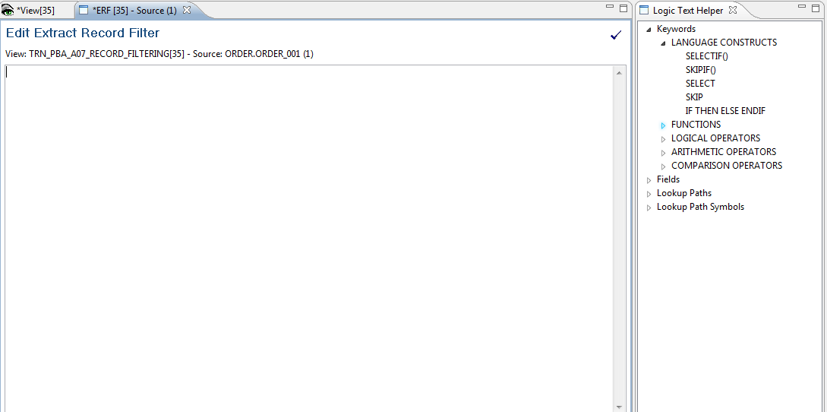
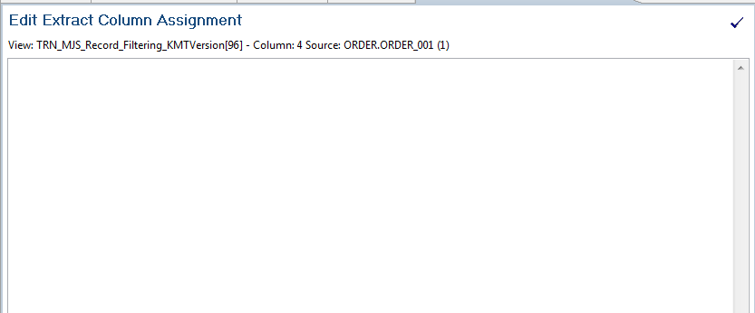
Record Filter versus Column Assignments
Record filtering either includes or excludes entire rows of data.
Field 1 Customer Name | Field 2 Customer Type | Field 3 Order Date
ABC Corp | Commercial | Jan 2000
Dan and Sally J | Retail | March 2006
State of Georgia | Government | April 2005
Fred and Katy H | Retail | Dec 1990
IF ({ORDER_DATE}>"20000101") THEN
SELECT
ELSE
SKIP
ENDIF
Column assignment and column calculations populate output record columns.
Column 1 Count of All Customers | Column 2 Count of Retail Customers | Column 3 Count of Commercial Customers | Column 4 Other Types of Customers
1 |  | 1
1 | 1
1
IF ({CUSTOMER_TYPE}=“RETAIL") THEN
COLUMN = 1
ELSE
COLUMN = 0
ENDIF
Notes:
In contrast to record filtering, GenevaERS also provides column assignment logic and column calculations, which also use GenevaERS logic text. Column logic is used to populate output columns with field values, constants, or calculations.
In the top example, record filtering excluded all customers with orders before January 2000. In the bottom example, columns are populated based upon customer type, either retail or commercial. Note that no value is assigned for the third record because it is for a “government” customer.

Slide 5
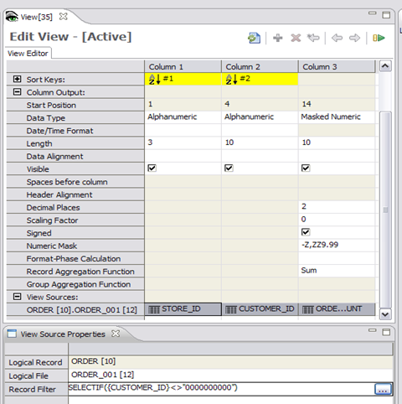

Extract Record Filter
Click in the View Source cell, and then click Record Filter.
Notes:
© Copyright IBM Corp. 2012, licensed under Apache 2.0 to the GenevaERS project
The extract record filter is opened on the View Source Properties tab. First, open the View Source Properties tab with a single left-click in the blue cell. Open the Extract Record Filter tab by double-clicking anywhere in the record filter cell to display the icon, and then click the icon.

Slide 6
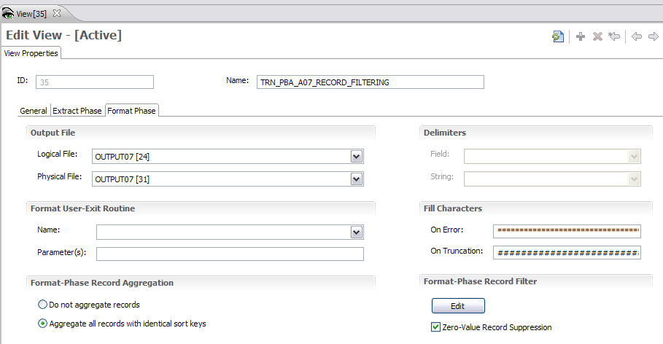
Format Phase Record Filter
Format Phase Filters
Notes:
© Copyright IBM Corp. 2012, licensed under Apache 2.0 to the GenevaERS project
The Format phase record filter is opened on the Format Phase tab on the View Properties screen. Simply click the Edit button to work with output record filters.

Slide 7
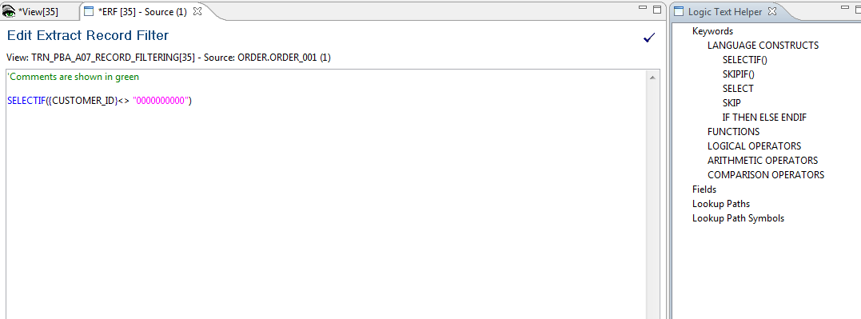
Logic Text Editor
Filter logic
Available language constructs
Notes:
© Copyright IBM Corp. 2012, licensed under Apache 2.0 to the GenevaERS project
GenevaERS logic text is constructed in the Logic Text Editor. The left panel displays the logic, and the right panel displays the Logic Text Helper, which displays key-words and values that can be used in logic text. Within logic text, comments are preceded by an apostrophe, and are shown in green. Keywords are shown in blue. Field names are shown in black, and alphanumeric constants are shown in pink, enclosed in pink double quotes.

Slide 8
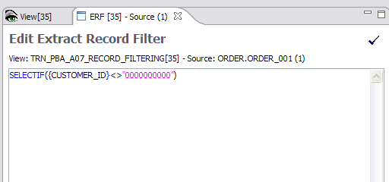
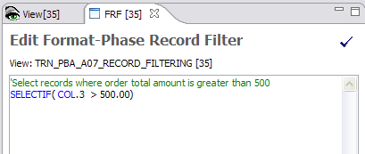
Fields versus Column Numbers
Extract Phase
The Extract phase uses LR field names, such as {CUSTOMER_ID}.
Format Phase
Format logic uses column numbers, such as Col.3.
Notes:
© Copyright IBM Corp. 2012, licensed under Apache 2.0 to the GenevaERS project
Because the Extract process has access to the original input record, extract record filters use field names and LR names. In GenevaERS meta-data, for example, field names are enclosed in brackets. Format phase logic text filters refer only to column numbers, not to field names.

Slide 9
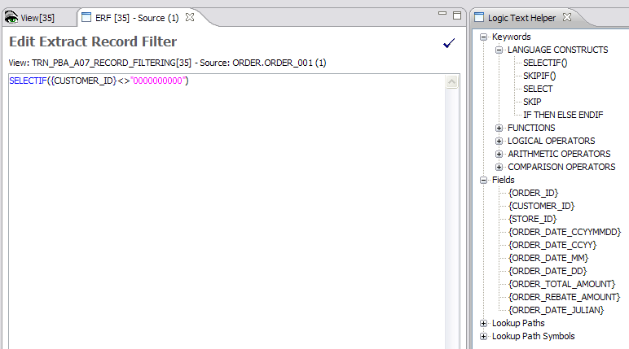
Record Filters – Logic Text Helper
Logic Text Helper
Notes:
© Copyright IBM Corp. 2012, licensed under Apache 2.0 to the GenevaERS project
The logic text helper enables you to build logic text by selecting the text to include in the filter. Double-clicking any listed keyword or field places that value in the logic text. Constants, such as the pink zeros shown here, are the only portion of the logic text that requires manual entry.

Slide 10
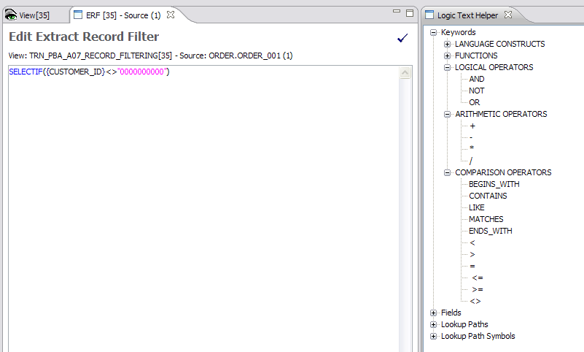
Logic Text Helper – Operators
Notes:
© Copyright IBM Corp. 2012, licensed under Apache 2.0 to the GenevaERS project
The Logic Text Helper includes operators, such as these:
Logical operators (AND, OR, NOT)
Arithmetic operators
Comparisons such as GREATER THAN or LESS THAN, and
Keywords, such as LIKE and CONTAINS.

Slide 11
Record Filter Language Constructs (1 of 2)
IF ({ORDER_DATE}>"20000101") THEN
SELECT
ELSE
SKIP
ENDIF
Notes:
© Copyright IBM Corp. 2012, licensed under Apache 2.0 to the GenevaERS project
The SELECT and SKIP key words tell the Performance Engine which record to select or skip. The logic shown in this example selects all records with an order date greater than January 1, 2000. All other records will be skipped.

Slide 12
Record Filter Language Constructs (2 of 2)
SELECTIF({ORDER_DATE}>“20000101")
SKIPIF({ORDER_DATE}<=“20000101"))
Notes:
© Copyright IBM Corp. 2012, licensed under Apache 2.0 to the GenevaERS project
The SELECTIF and SKIPIF statements provide a shorthand way of specifying the same condition. Note that the greater-than sign has been switched to a less-than-or-equal-to sign, so that both statements will select the same records.

Slide 13
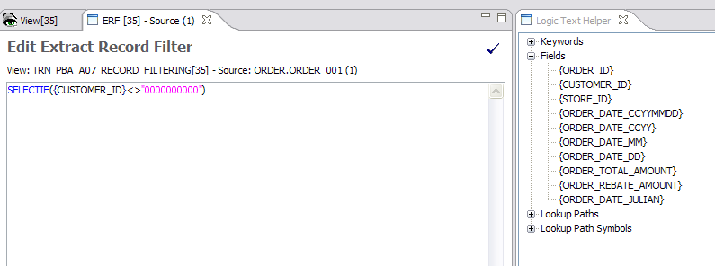
Logic Text Helper – Fields
Notes:
© Copyright IBM Corp. 2012, licensed under Apache 2.0 to the GenevaERS project
The Logic Test Helper includes a listing of all fields from the input logical record. To avoid syntax errors, place the cursor at the correct location in the GenevaERS keyword, and double-click to insert the selected field name.

Slide 14
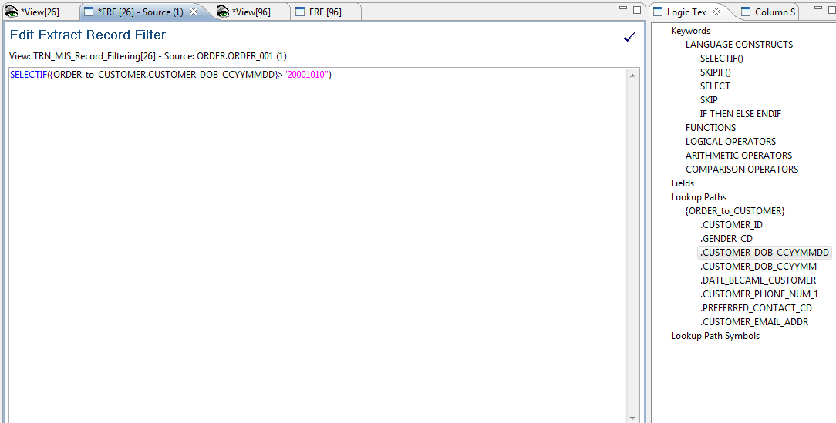
Logic Text Helper – Lookup Path
Notes:
© Copyright IBM Corp. 2012, licensed under Apache 2.0 to the GenevaERS project
The Logic Text Helper also shows all lookup paths and fields on LRs available through joins. When used in logic text, these field names are preceded by the lookup path name.
In this example, the logic tests the customer date-of-birth field, looking for records with specific dates to include or exclude.

Slide 15
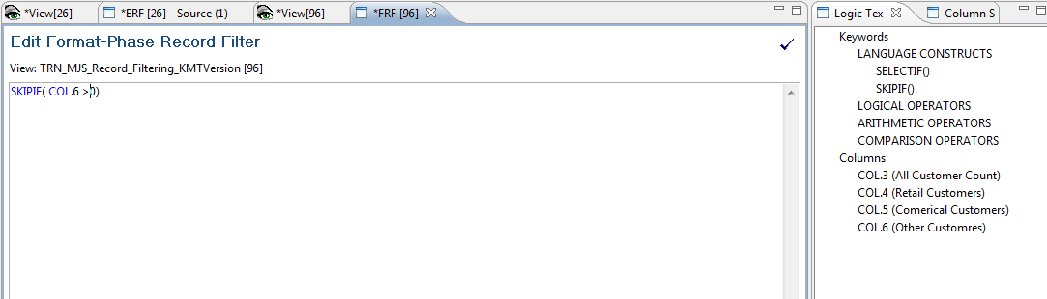
Format Phase Output Record Example
Detailed Records
Summarized Records
Selected?
Customer Name | Order Count (Column 6)
Johnson | 2
Johnson | -3
Johnson | 1
Customer Name | Order Count
Johnson | 0
X
Philips | 1
Philips | 1
Philips | 1
Philips | 3
√
Notes:
© Copyright IBM Corp. 2012, licensed under Apache 2.0 to the GenevaERS project
Format filtering can be performed only on records that have made it through record selection, in the Extract phase. Format phase output record filtering refers to columns rather than field numbers. The only columns available for output filtering are columns that are numeric, perform aggregation, or are the results of calculations. Format filtering is applied after aggregation is performed.
In this example, only records where column 6 is greater than 0 are written to the final output file. The accumulated order count in column 6 for Johnson is 0, so this record is not written to the output file, but the Philips record, with a total of 3, is.

Slide 16
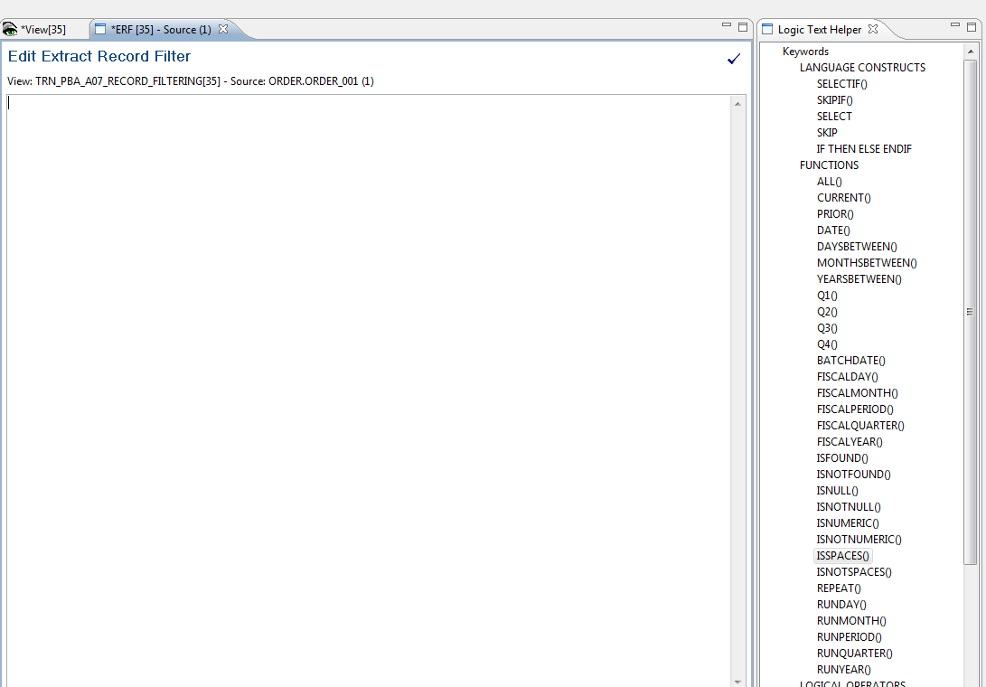
Logic Text Helper – Functions
SKIPIF(ISSPACES{ORDER_DATE})
Notes:
© Copyright IBM Corp. 2012, licensed under Apache 2.0 to the GenevaERS project
Logic text functions test numerous conditions, including various date conditions, nulls, numeric values, and found and not-found conditions on joins. In this example, all records with spaces in the ORDER DATE field will be skipped.

Slide 17
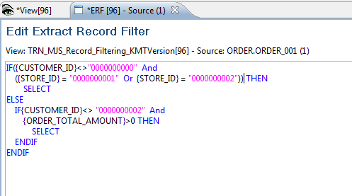
Logic Text Helper – Example
Notes:
© Copyright IBM Corp. 2012, licensed under Apache 2.0 to the GenevaERS project
Logic text supports nested IF statements. GenevaERS logic text follows the typical order of operations and logic constructs of other programming languages.
In this example, all order records for customer 0 at stores 1 and 2 are selected. In addition, all orders for customer 2 at any store, with an amount less than or equal to 0, are selected for processing.

Slide 18
Logic Text Helper – ISFOUND
SELECTIF(ISFOUND{ORDER_to_CUSTOMER})
Notes:
© Copyright IBM Corp. 2012, licensed under Apache 2.0 to the GenevaERS project
The ISFOUND (is found) and ISNOTFOUND (is not found) functions test the results of joins. If a corresponding join record is found, the ISFOUND condition tests true. The parameter for these functions is simply the lookup path to be tested for a valid join.
In this example, order records are selected if a customer record is found using the order-to-customer lookup path.

Slide 19
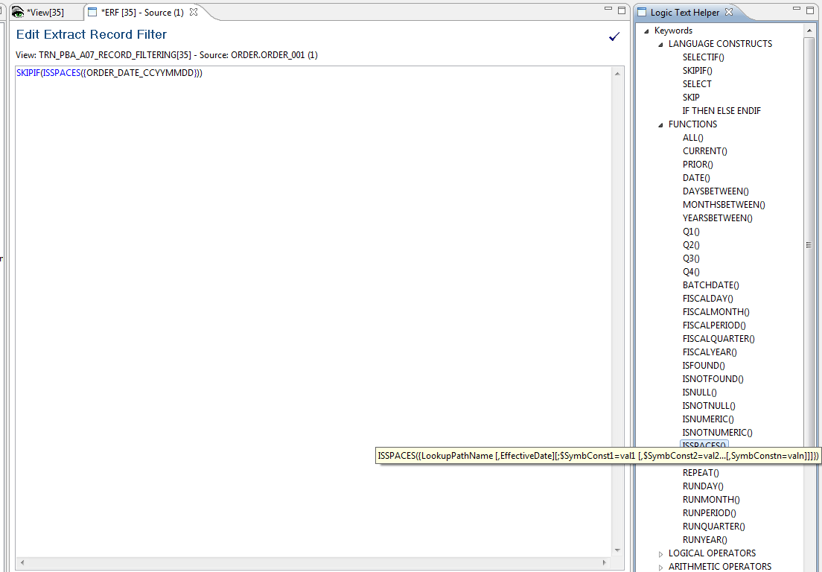
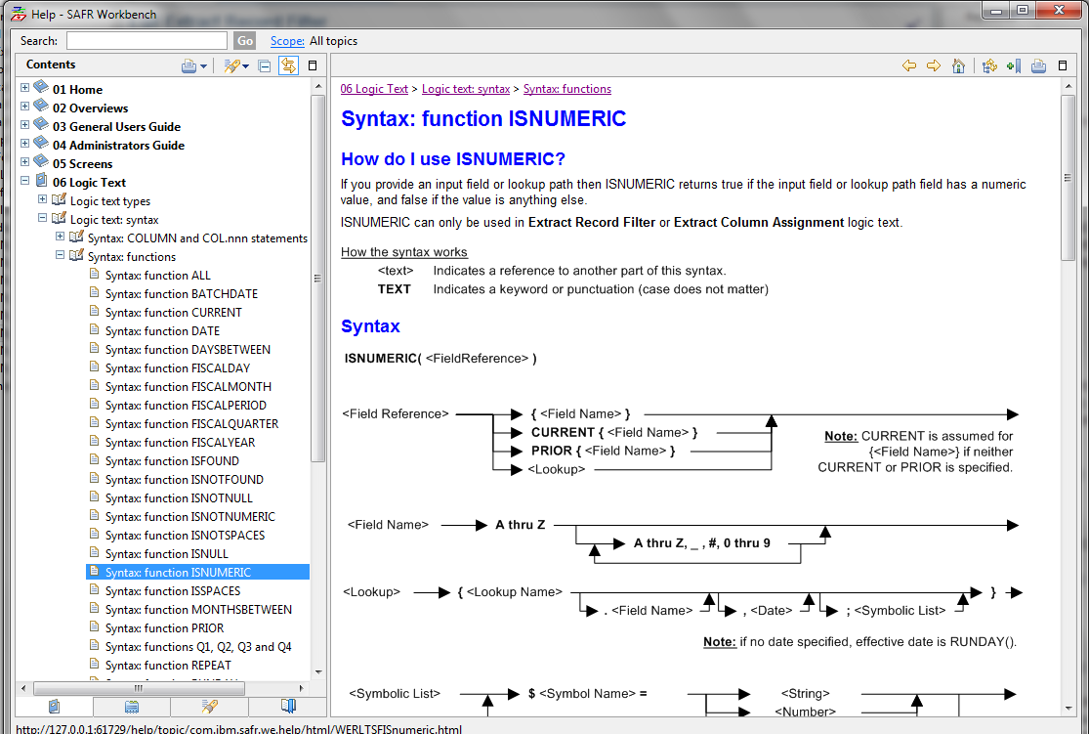
Logic Text Helper – Help
Access help by opening the Help menu and selecting Logic Text.
Notes:
© Copyright IBM Corp. 2012, licensed under Apache 2.0 to the GenevaERS project
To view a quick syntax snapshot, hover over the Logic Text Helper keywords. GenevaERS online help provides full syntax help for all keywords. To access help, open the Help menu and, select Logic Text.

Slide 20
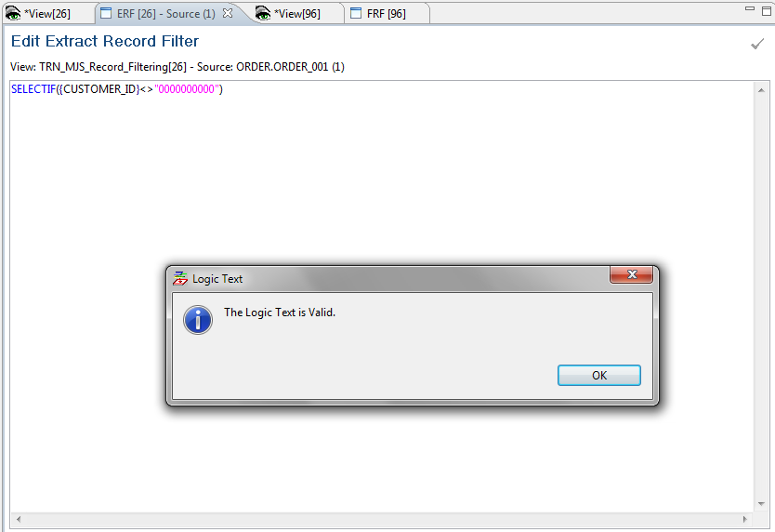
Logic Text Helper – Syntax Checking
Syntax Checker
Notes:
© Copyright IBM Corp. 2012, licensed under Apache 2.0 to the GenevaERS project
Logic text syntax checking tests logic text for errors, such as mistyped keywords or invalid field names. Error messages are displayed at the bottom of the screen. Views cannot be activated until all errors are cleared.

Slide 21
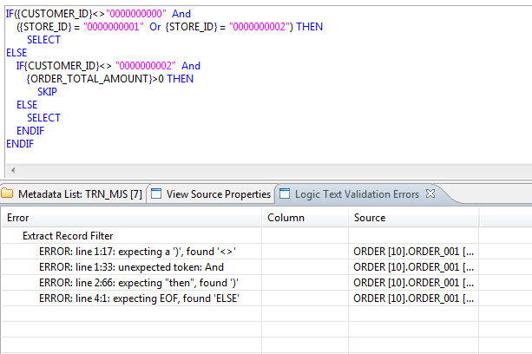
Logic Text Helper – Syntax Errors
Logic is missing a second ) here
Notes:
© Copyright IBM Corp. 2012, licensed under Apache 2.0 to the GenevaERS project
Logic text syntax checking displays errors when syntax is not correct. The error message displays the line followed by the character number where the error was detected.
In this example, the syntax is missing a second right parenthesis after the constant “2.”

